Slide 1


Keep America Beautiful - Litter Detective (Machine Learning)

Slide 2
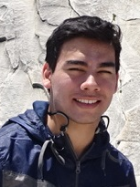
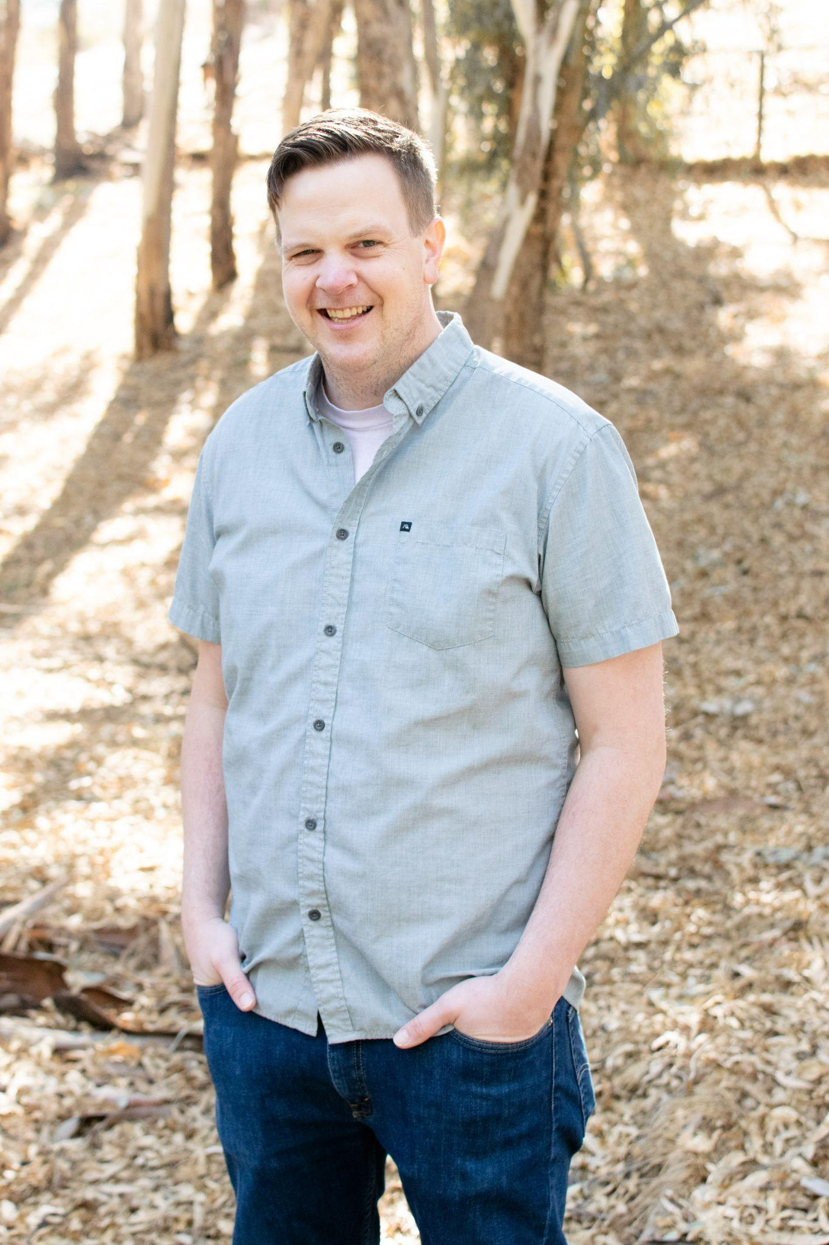

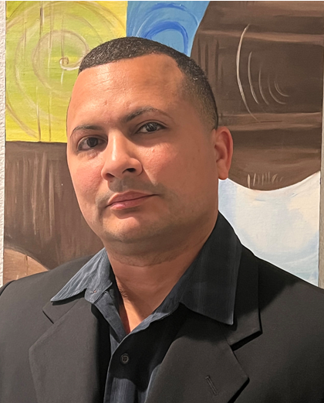
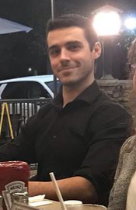
Meet the Team
Team/Scrum Leader: Noah Miera
Programmer: Keith Gross
Project Manager: Juan Gonzalez
Programmer: Miguel Morales
Documentation/Training: Jordan Fisher

Slide 3

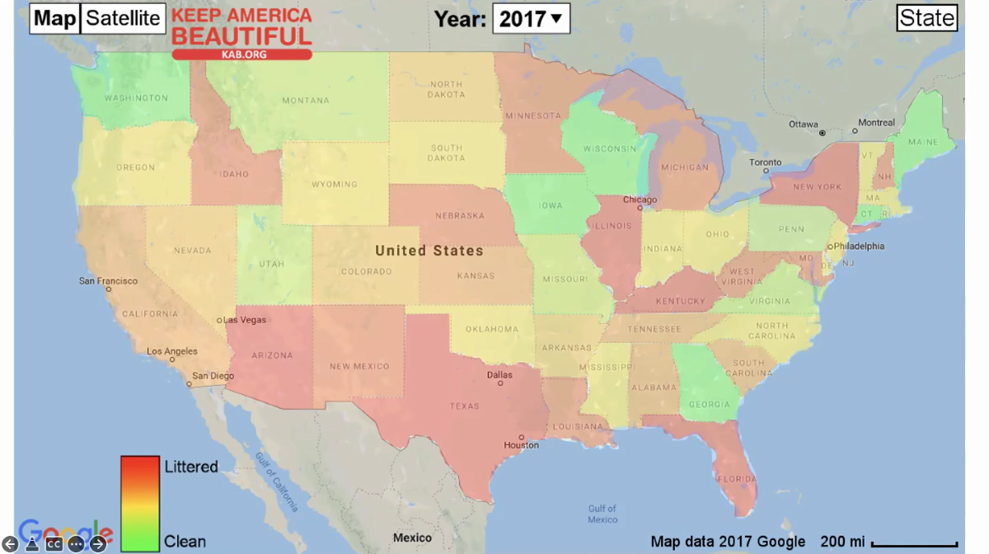
Purpose
Keep America Beautiful is a leading national nonprofit organization that inspires and educates people to take action every day to improve and beautify their community environment. They envision a country in which every community is a clean, green, and beautiful place to live.
With a Machine Learning algorithm that can detect instances of litter, the data produced will be integrated into a functional User Interface/Web App, in order to help graphically represent the level of litter from any location in the world.

Slide 4
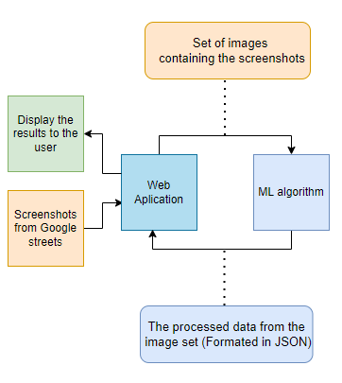
M.L Project Requirements
As the Machine Learning team, we operated with the following requirements:
Develop a system to receive and process Google Street images from a user (Web App Team).
Develop a Machine Learning algorithm that must be able to detect instances of litter in the received Google Street images.
Once the litter instances have been identified, the system must then process and output the results into a suitable format, such as JSON, for the user (Web App Team).
Once the results have been made, the system must then return the processed data to the user (Web App Team).
Train the final algorithm to categorize different kinds of litter. (Contingent on the completion of other requirements)

Slide 5
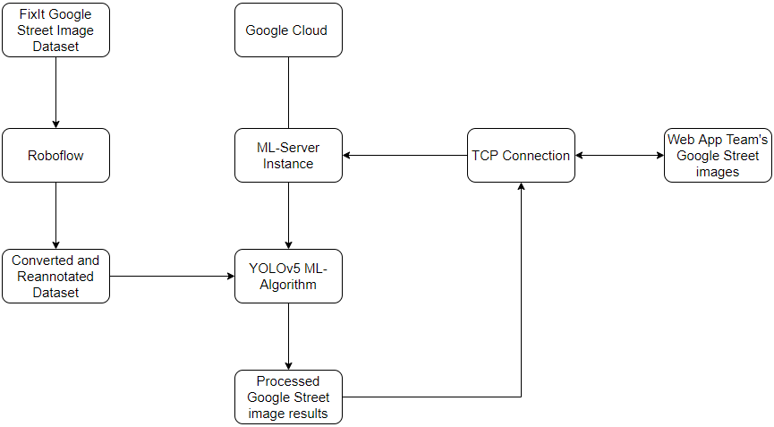
Closer View - Network Diagram

Slide 6
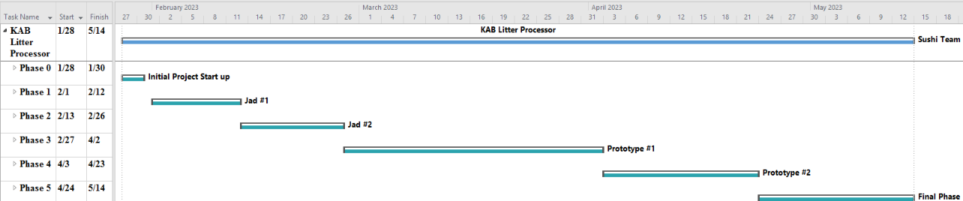
Project Management - Timeline
JAD #1: Identify initial requirements and technical specifications for the project.
JAD #2: Identify the final requirements and technical specifications for the project.
Prototype #1: Process images through the Machine Learning algorithm to produce litter metrics.
Prototype #2: Able to sync up the input/output format of the Machine Learning algorithm with the Web App team, as well as refine the algorithm's litter detection.
Final Product: Collation and transfer of litter metrics from images, received by the Web App team, that have been processed through a Machine Learning algorithm, for the Web App team’s use.

Slide 7
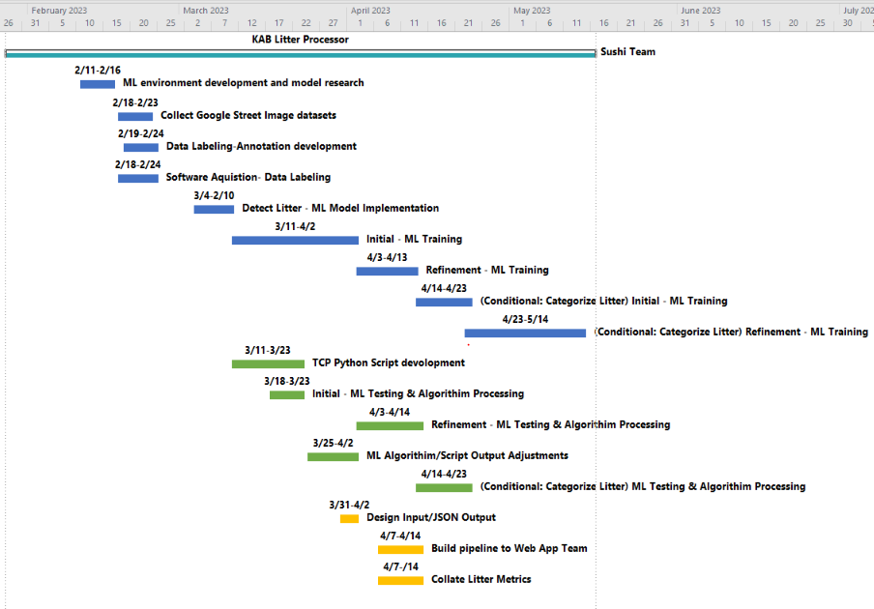
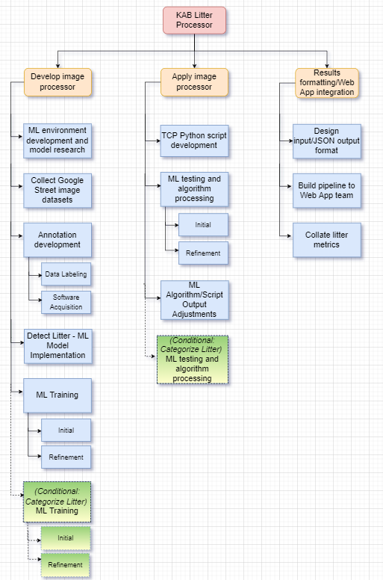
Project Management - Main Tasks

Slide 8
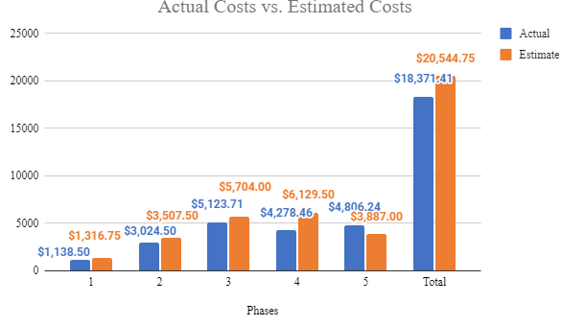
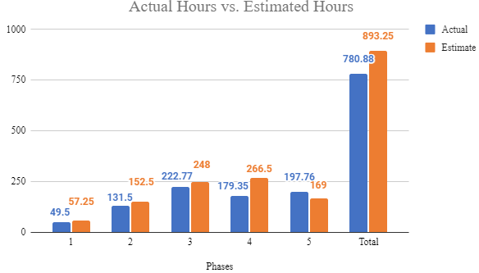
Project Management - Estimated vs Actuals
We will assume an hourly rate of $23.00 per hour for this project.
The usage of our Google Cloud server costed $0.37 cents per hour to run.
Google Cloud server costs were only accrued within Phases 4 & 5.

Slide 9
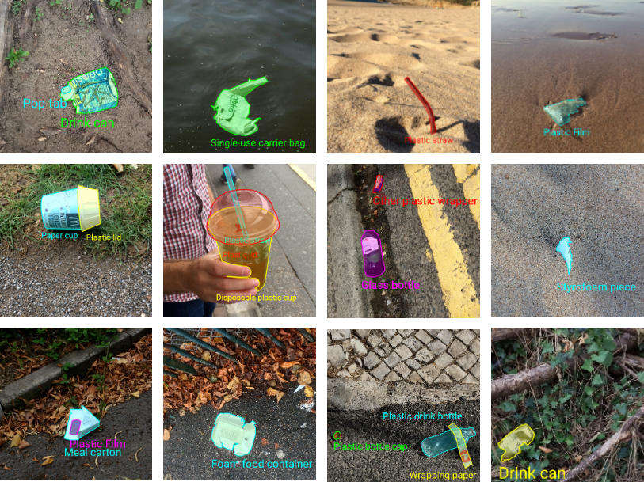
Development Process - Research
Trash Annotations in Context (TACO)
Advantages
Utilitzes Mask R-CNN Model
Variety of Litter Objects
Segmented into Categories
Disadvantages
High Resolution Images
Scenes are unlike street view images
VGG Image Annotator
Advantages
Web based, nothing to download
Could host on our own and tailor to our needs
Easy to use
Disadvantages
All images in single project
Not team friendly

Slide 10
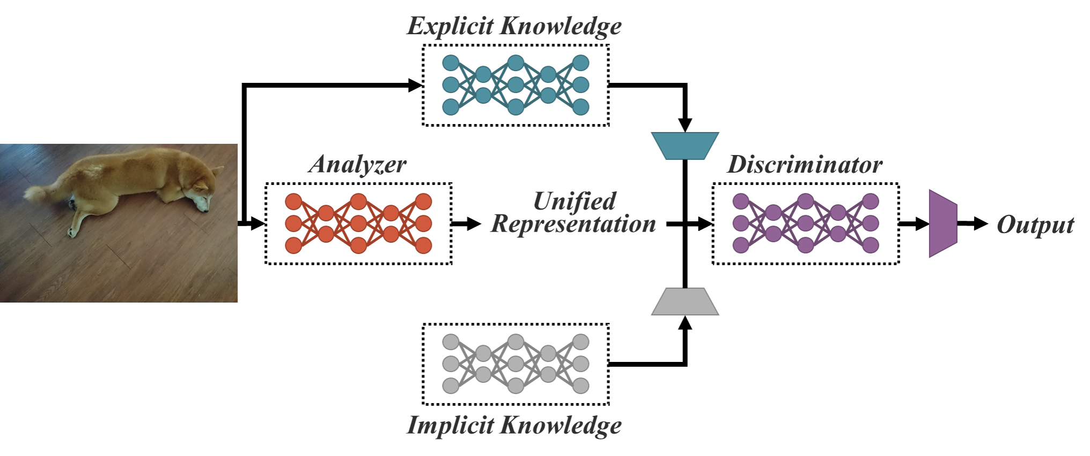

Development Process - Tools & Resources
YOLOR - You Only Learn One Representation
Object Detection Model
Unified Network that joins Explicit and Implicit Knowledge
Faster detection time without loss of accuracy
Implicit Knowledge can be used for multiple tasks.
Roboflow
Online Computer Vision Startup
Free Image Annotation Tool similar to VGG Image Annotator
Slightly more user control and collaboration tools
Easily export datasets with different annotations
Google Cloud Instance
4vCPUs, 26 GB memory, 100 GB Balanced Persistent Storage
NVIDIA Tesla T4 GPU - Cost Efficient GPU for machine learning
Google’s Deep Learning optimized Debian 10 image
Shared Access between group members

Slide 11
Development Process - Tools & Resources
YOLOv5 - You Only Look Once
Design
Object Detection Algorithm
Divides Image into grid
Each Cell is responsible for detecting objects within itself
Benefits
Utilizes Current PyTorch machine learning framework
Faster object detection processing - Low Overhead
Training optimization using SGD
Integration with Weights and Biases - Online real-time hyperparameter and training monitor
Google Street API and New Dataset
Improved Street Image Collection Parameters
Tighter FOV (40 Degrees)
Downward Pitch ( -20 Degrees)
Polygon Annotations
Opportunity for Object Classification

Slide 12
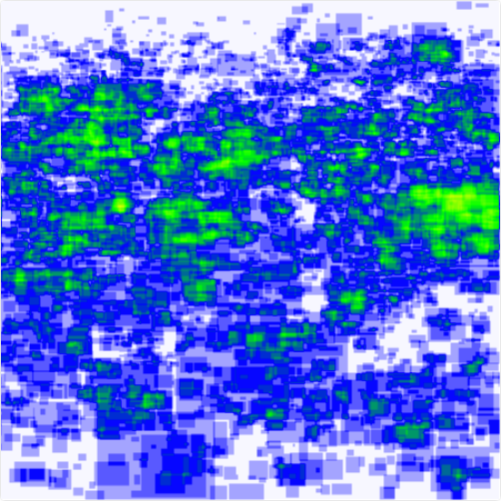
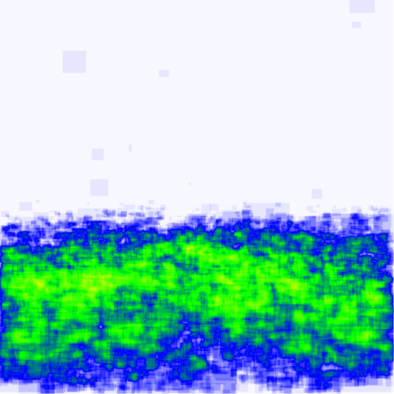
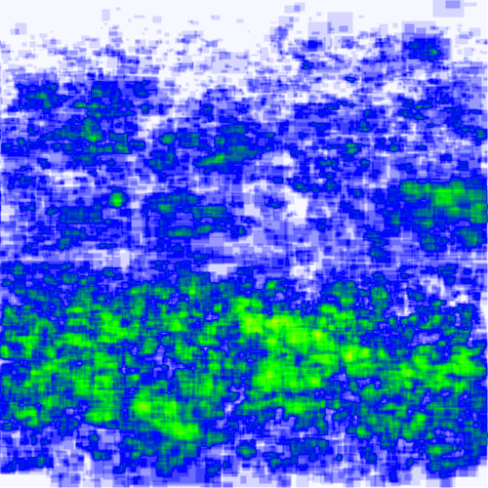
Development Process - Dataset
Annotation Heat Map (New)
New Dataset
10,000 images collected from Web APP team
1,647 images contained litter
4,445 unique annotated objects
Multiple Classes
Old Dataset (FixIt)
2,490 Images
10,027 unique annotated objects
Single “Litter” Class
Merged and Processed
5,533 Images
9,235 unique annotated objects (filtered)
Classes collapsed into single “Litter” Class
Annotation Heat Map (Old Dataset)
Annotation Heat Map (Merged)

Slide 13
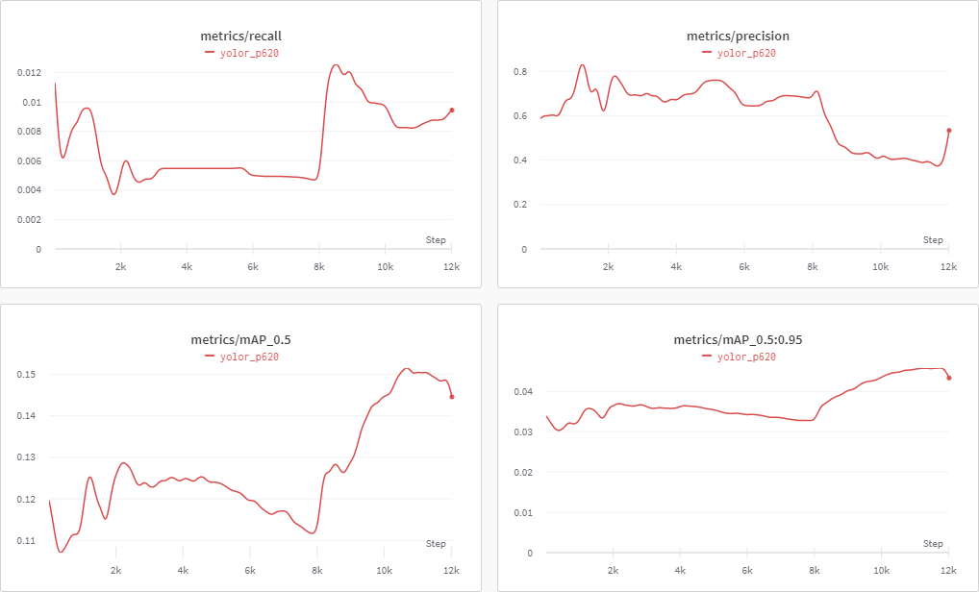
Development Process - Training
Google Cloud Instance Training
Allowed our team to train in the background
Increased from standard machine type to highmem
Allowed more than one user on machine at a time
Image caching during training
Machine Learning
Precision - Of All Detected Objects, How many are correct
Recall - Of All Objects we want, How many did it detect
mAP - Average Precision Values over Recall Values
YOLOR
Began Training with YOLOR Model
Needed to modify code to get rid of errors
Results showed High Precision but Low Recall
Model not sustainable with our goals

Slide 14
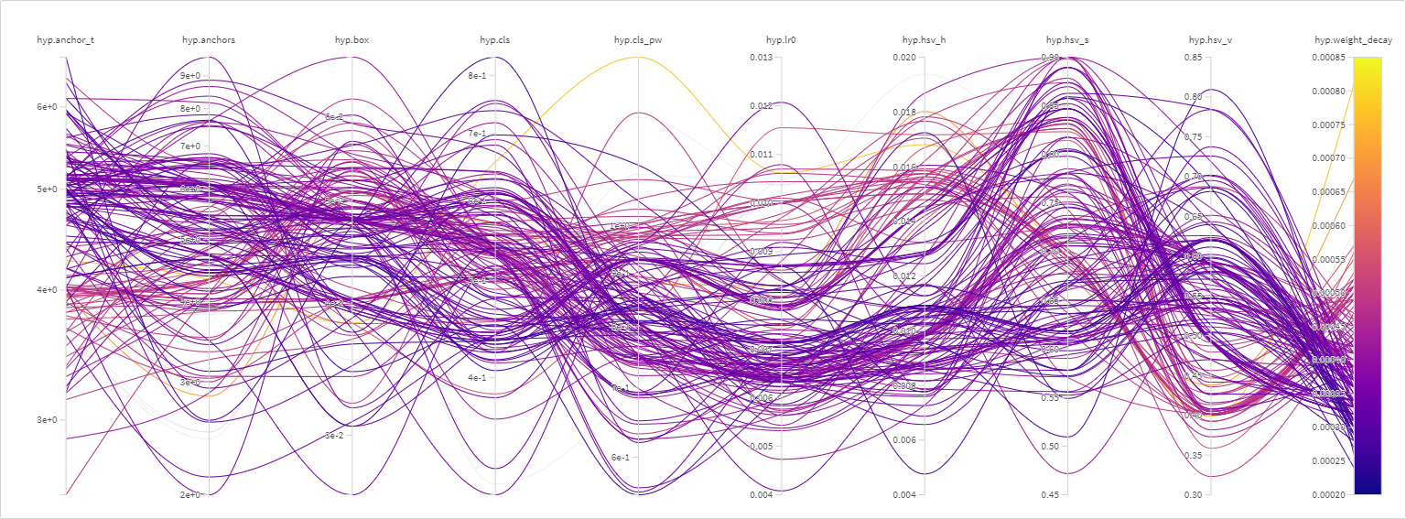
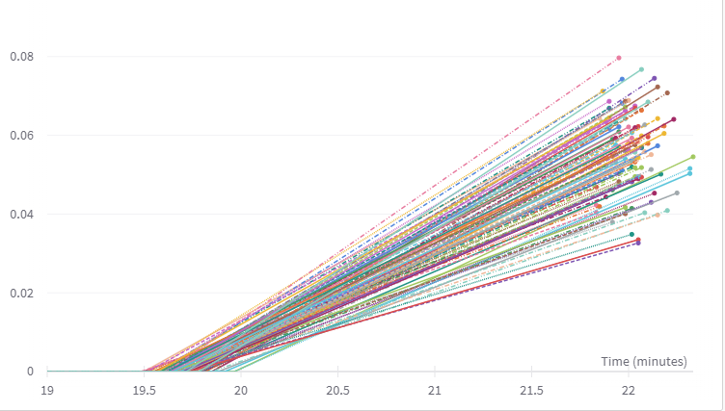
Development Process - Training
YOLOv5 Training
Switched to YOLOv5
Able to convert polygon annotations to bounding boxes
Active development
Modified Code
Reject Boxes with sides less than 7 pixels
Hyperparameter Evolution Training
Varies 25 different training parameters and saves the best result
Ran 300 generations of 10 epochs to find best initial hyperparameters
Ran full training of 300 epochs
Using Old Dataset
YOLOv5l configuration - Large Model
Re-Ran using this generated weight as starting point for additional 300 epochs with high augmentation hyperparameters for final results

Slide 15
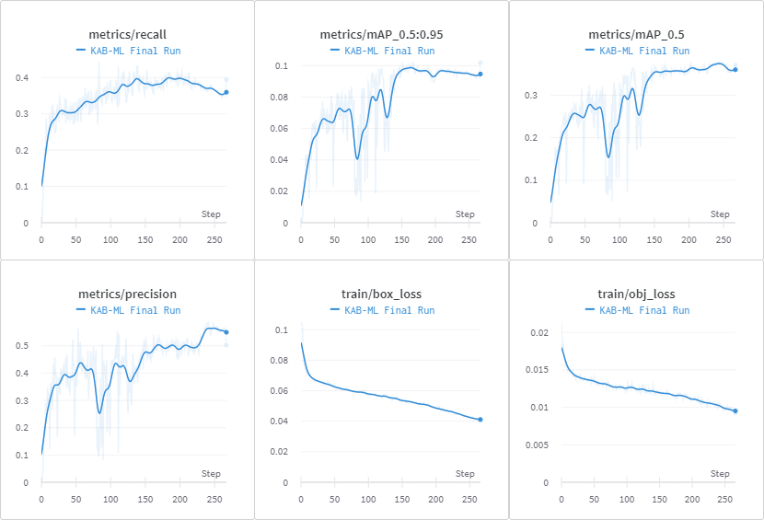
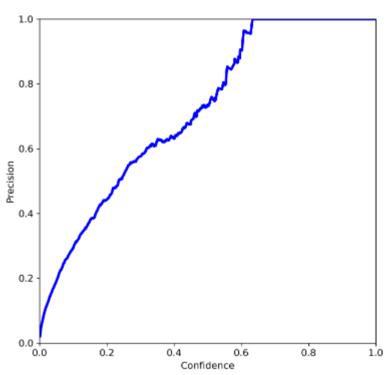
Development Process - Results
Precision at 50.23% Recall at 39.38% mAP_0.5 at 37.18%

Slide 16
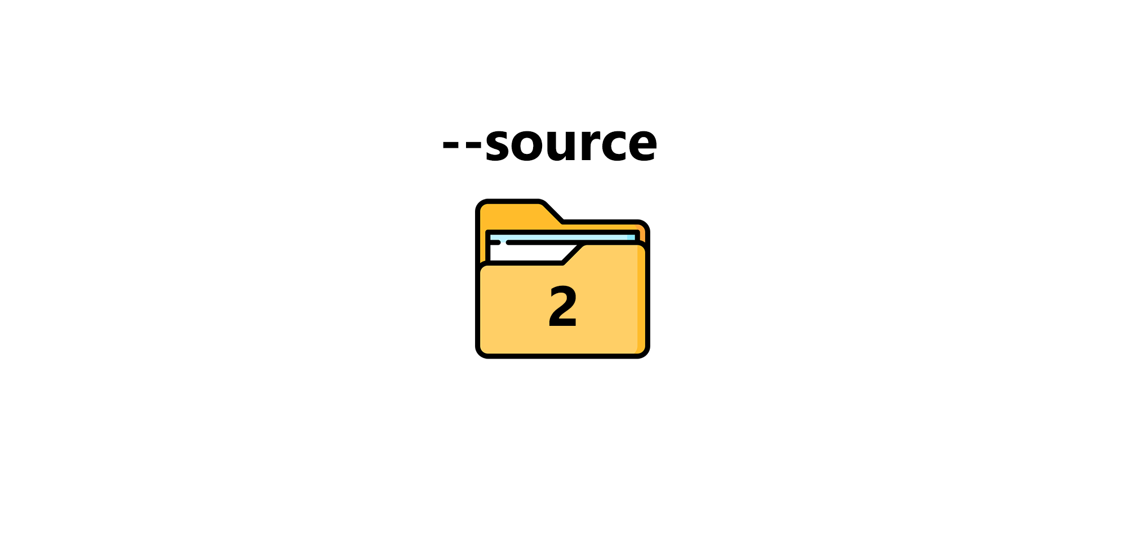
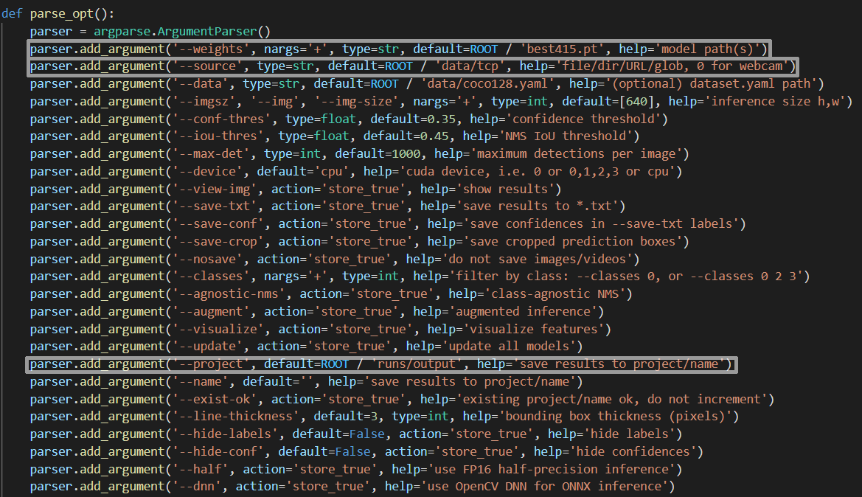
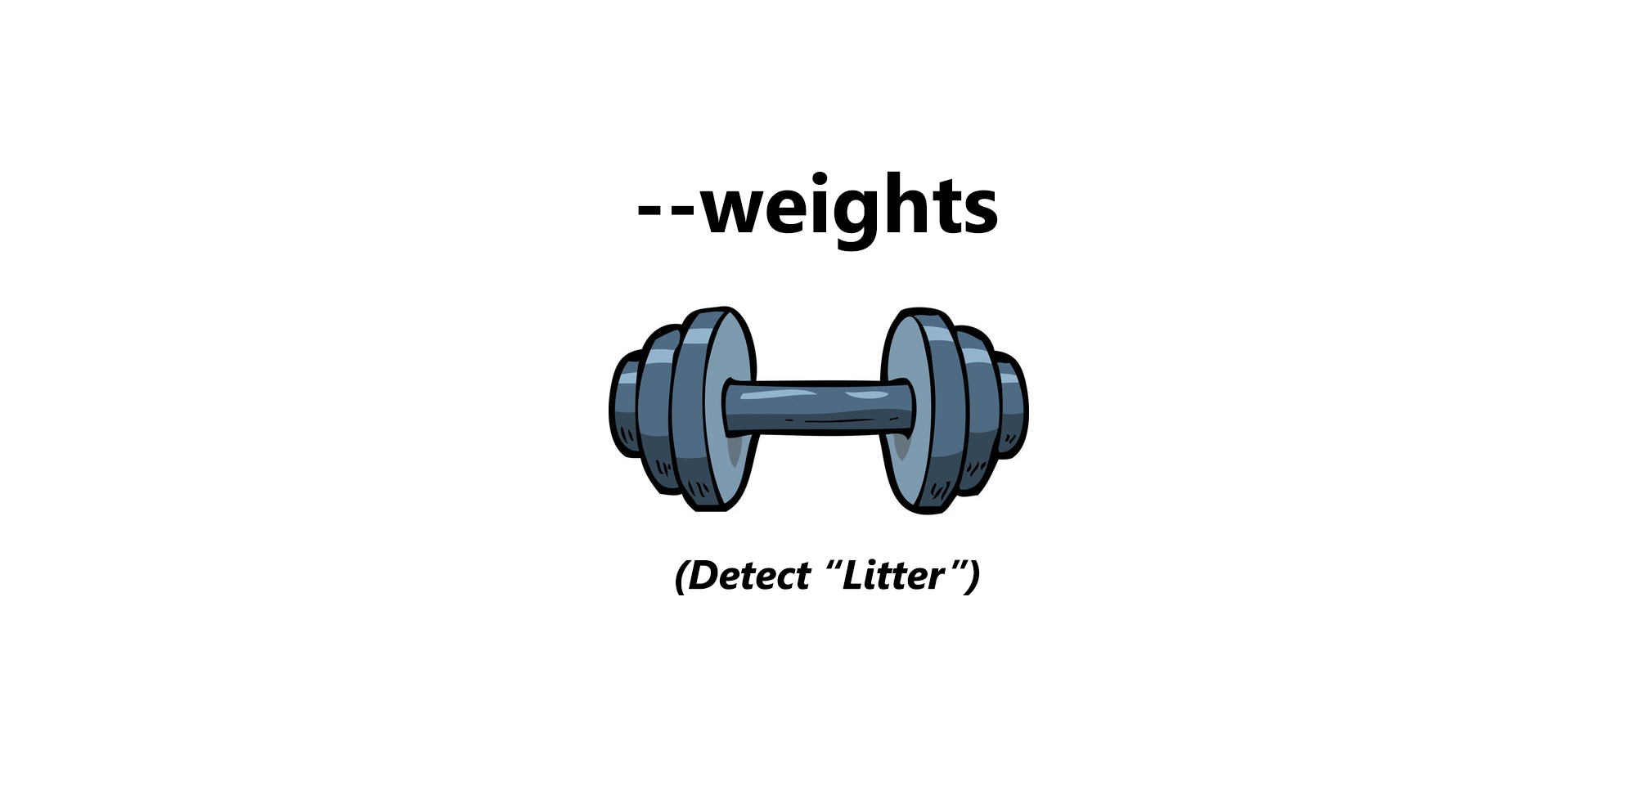
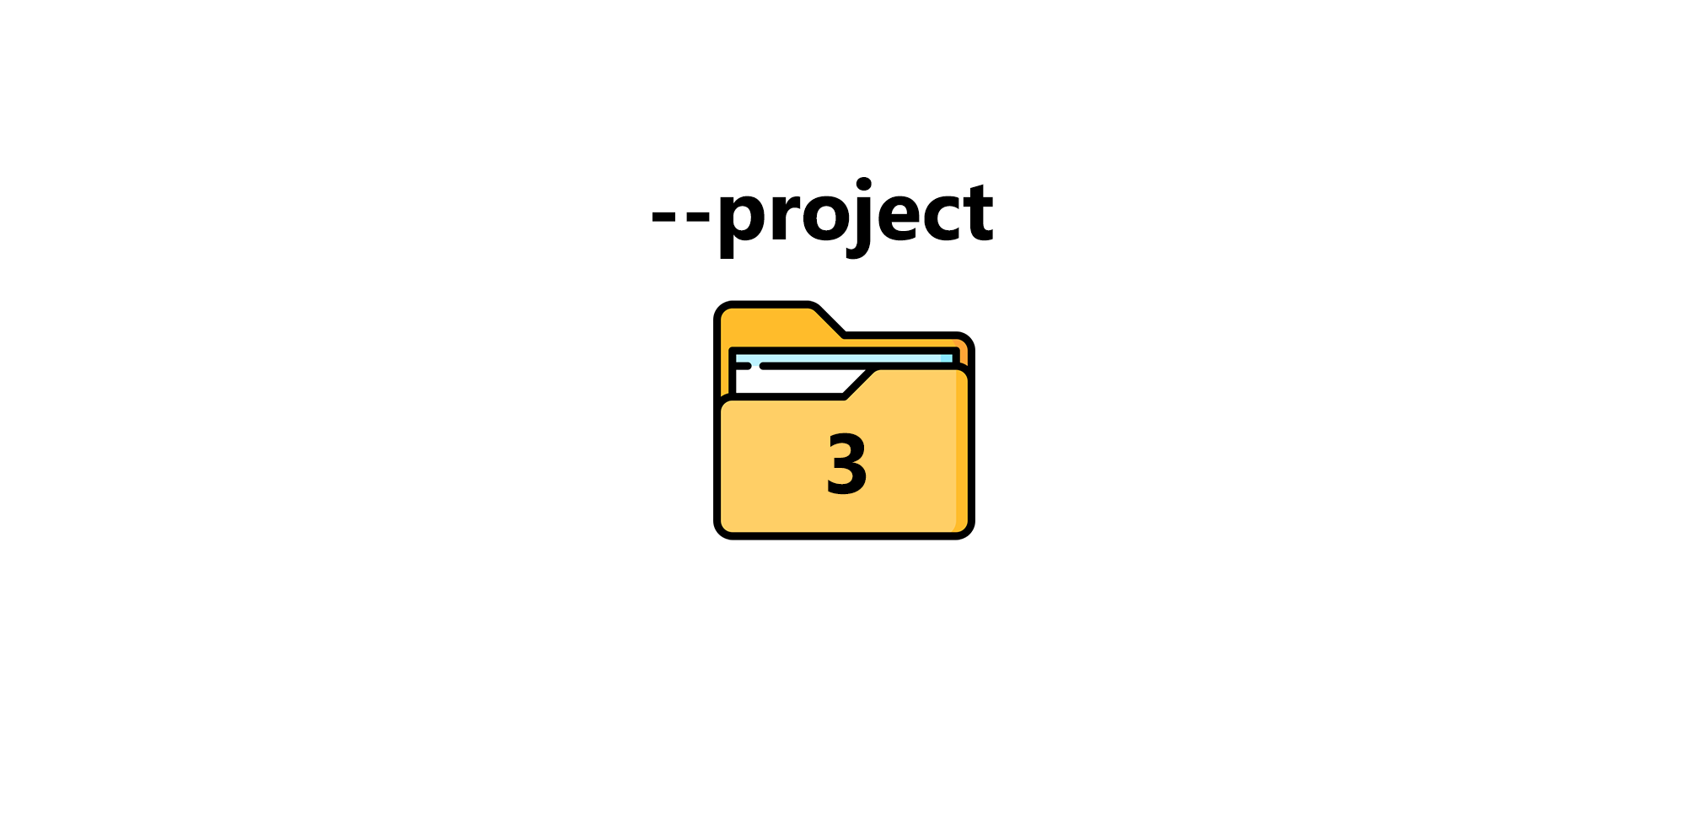
Development Process - Detection & Hook
YOLOv5’s DEFAULT values:
python detect.py --source data/images --weights yolov5s.pt --conf 0.25 --img-size 1280 --device 0

Slide 17
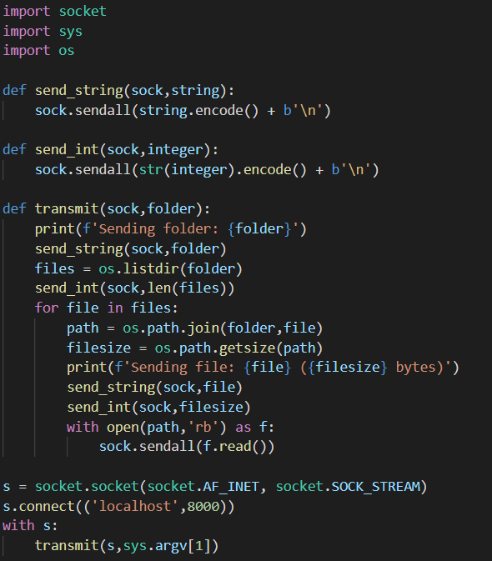
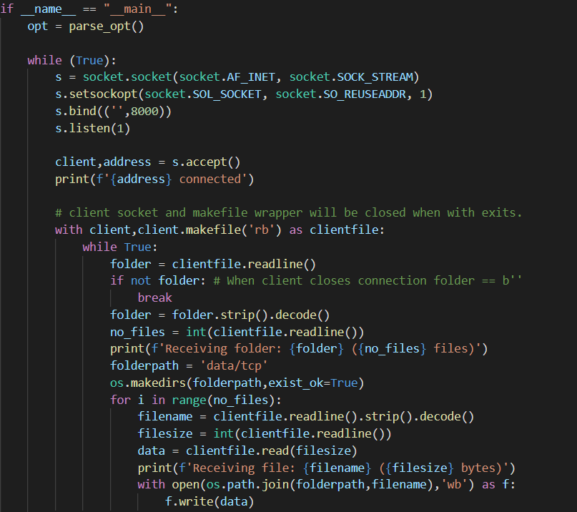
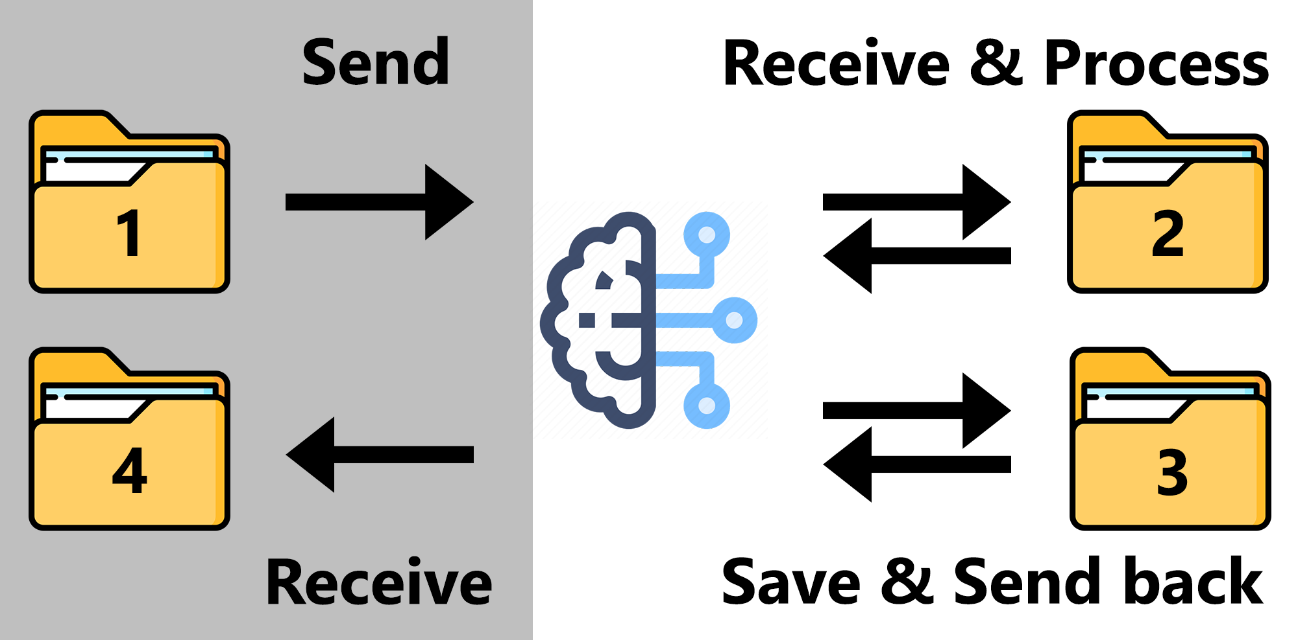
Development Process - Detection & Hook (cont.)
TCP connection: Sending a MULTIPLE images/contents of a folder.
Client side
Server side
$ python server_detect.py
$ python client.py client_images

Slide 18
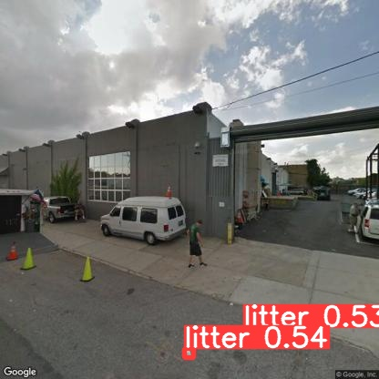
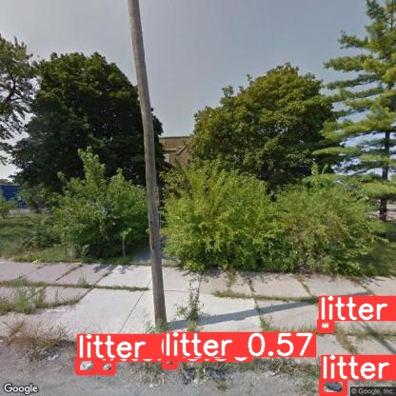
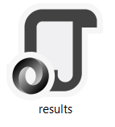
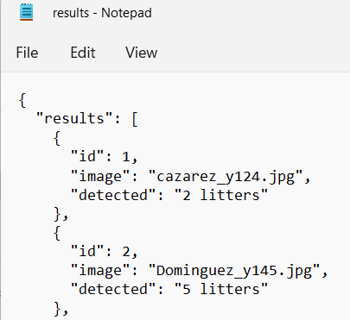
Development Process - Detection & Hook (cont.)

Slide 19
Run Demo

Slide 20
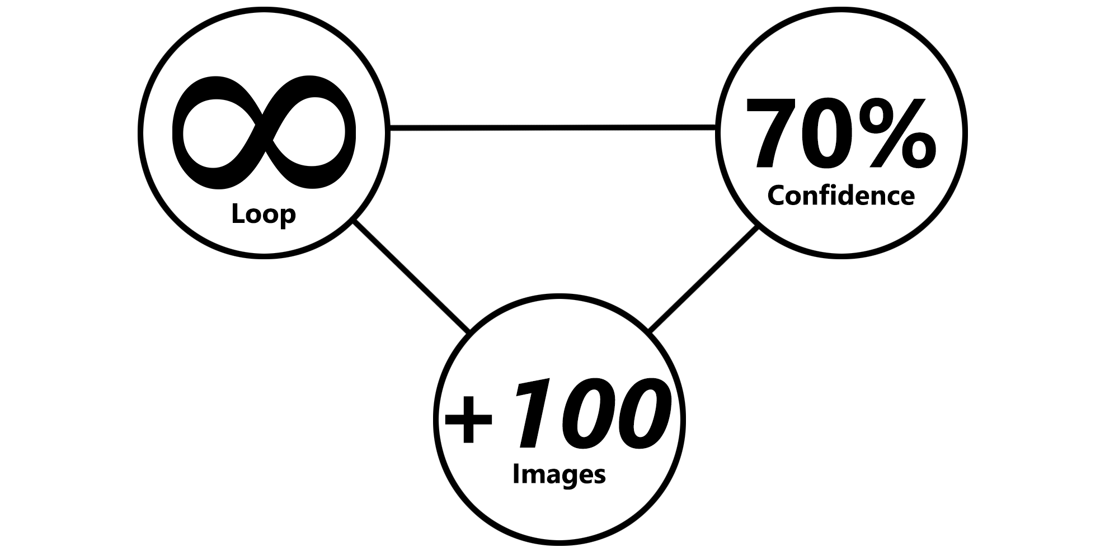
Development Process - Detection & Hook (cont.)
Server/Machine Learning Algorithm will be constantly running, ready for new sets of images.
Designed as well to avoid complications of unneeded GPU usage, unnecessarily used space, and re-doing already processed images again.
In terms of the results, our ML algorithm is able to detect litter within Google Street images with a confidence level ranging from 35% to 70%.
Most common pieces of litter detected will be Bottles, Cardboard, Paper, Grocery Bags, etc.
Our Machine Learning algorithm is able to handle over hundreds of images one after another, with no issues.
So far, we’ve tested it with 200 sized image batches, and each batch only takes about 3 minutes/200 seconds – about 1 second per image.

Slide 21
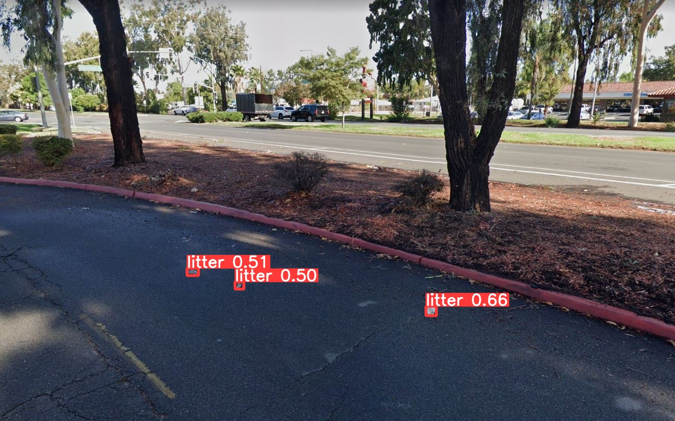
Development Process - Detection & Hook (extra)
(Low Res.) Street View Static API
Img-size = 640
(High Res.) Screenshot
Img-size = 1280

Slide 22
Final Deliverables
Machine Learning code/algorithm that will be compatible and usable with the Web App team.
Algorithm components:
Input: Google Street images
Litter detection (YOLOv5)
Output: Bounding box & JSON output (total amount of litter)
Show accuracy/confidence level in litter prediction
A scheduling hook by which the Web App team can use the algorithm:
KABML_server.py: TCP Server/Detection code
KABML_client.py: TCP Client code
NOT achieved - Conditional feature:
Categorize the litter (e.g. Plastic, Paper, Organics,...).

Slide 23




Documentation
Reports and Manuals for new users and programmers.
Roboflow: A general purpose Machine Learning site.
Setting up
Annotation process
Generate a Dataset
YOLOv5: An Object Detection Algorithm Model
Hyper-Parameters
Augmentations
Modified Bounding Box Acceptance
…
Google Cloud: Cloud Computing Service Platform
Machine requirements & Set up
TCP Connection & Detection Guide
How to use
How to modify
All located in our GitHub link located below.
https://github.com/SushiTeam2022/KAB-ML

Slide 24
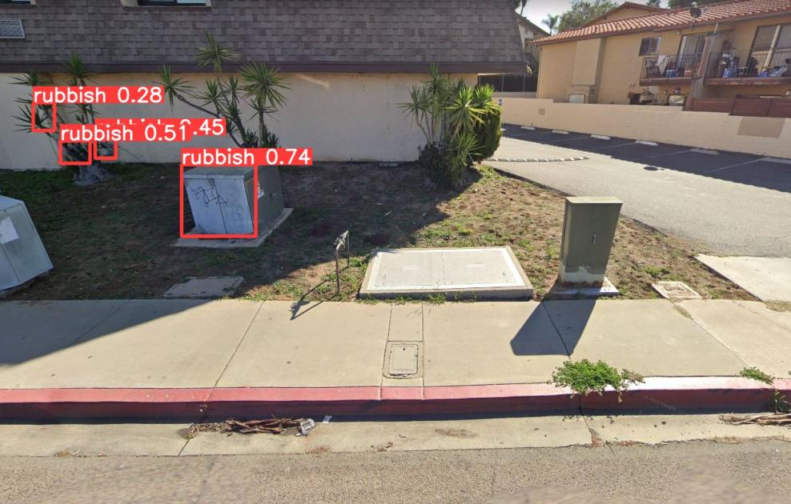
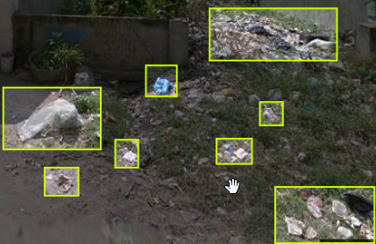
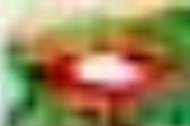
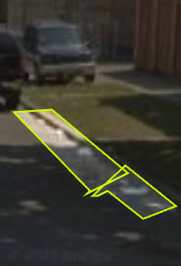
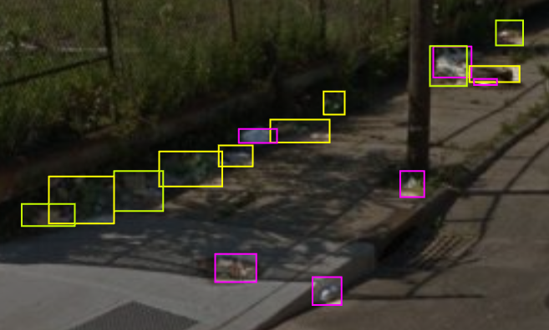
Challenges
(Cropped for presentation)
Old Dataset:
New Images Sources, due to poor resolution
Other sources: Covered multiples angles/too much variety in images for image collection.
Stuck with Google Street API images(consistent coverage).
New Annotations, due to poor annotations
Other sources: Were not compatible with Google Street images.
Re-annotated previous dataset to provide better accuracy.
New Dataset & Dr. Schultz’s Students:
Students were added to the project and were given specific instructions to just annotate. However:
Students adding themself “Jobs”.
Approving their own work & more.
Using wrong tool for annotation
Poor annotation quality
Creating the new class “litter” among the already provided classes.(paper, glass, plastic, organics, other)

Slide 25
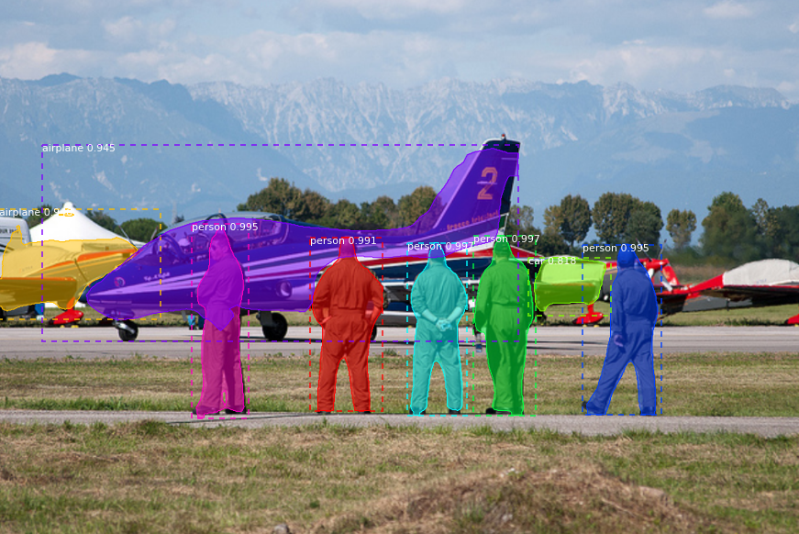
Challenges - Models
GENERAL
Models were ran from SSH Shell
Disconnect would cause failure of training
MASK R-CNN
Needs Masks - Old Dataset was only Bounding Boxes
Not updated in years - would need overhaul
YOLOR
Not routinely maintained
Limited to bounding box annotations
Modifications to code were needed to work with latest tools and releases
YOLOv5
Faster image processing results in lower accuracy
Constantly updating

Slide 26

Future Enhancements
A better Dataset:
Larger-sized images
More pixels to define objects
Less blur from compression
A new & more fortified annotation process:
Better control over your workspace/Dataset
Have a more dependable platform
More GPU:
Speed up the overall process of the project
Multiple process/detecting of litter at one time.
Expand to categorizing litter:
Categorize the litter (e.g. Plastic, Paper, Organics,...).

Slide 27
Feedback & Questions?

